Slide 1

A Homotopy Surface Cutting Using Paths Crossing in Geodesic Distance
Anuwat Dechvijankit
Hiroshi Nagahashi
Kota Aoki
Dept. Computational Intelligence and Systems Science
Imaging Science and Engineering Laboratory
Tokyo Institute of Technology, Japan

Slide 2
Outline
We present an enhancement method to generate a cut graph in high-genus surface for converting surface into topological disk.
Research Terms and Studies
Geometry Image
MMP Exact Geodesic Distance
Our method.
Results and Conclusion

Slide 3
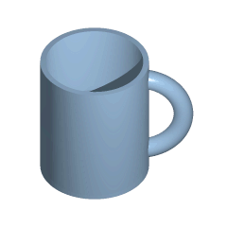
Topology & Genus
Topology is the mathematical study of the properties that are preserved through deformations, twistings, and stretchings of objects.
Genus is a topologically invariant property of a surface defined as the largest number of nonintersecting simple closed curves that can be drawn on the surface without separating it. Roughly speaking, it is the number of holes in a surface.
From: http://mathworld.wolfram.com/ Wikipedia

Slide 4
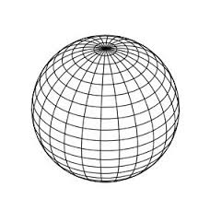
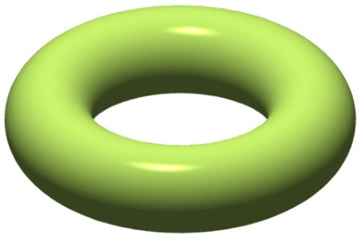
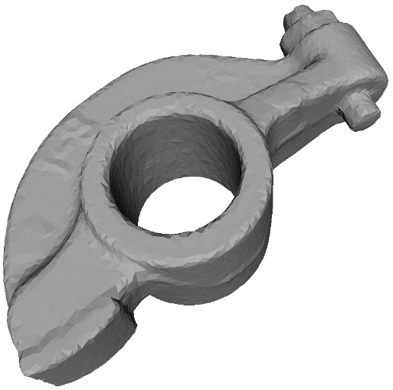
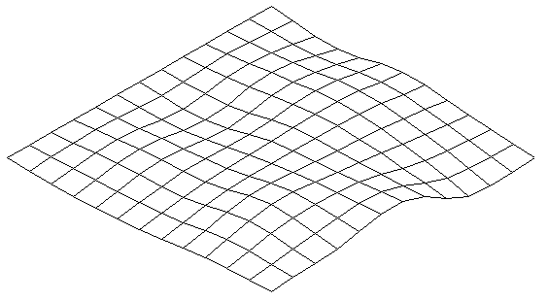
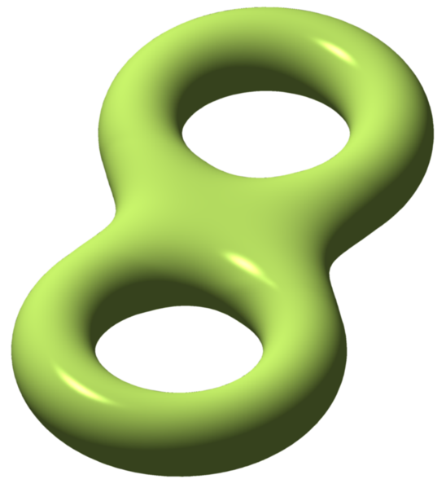
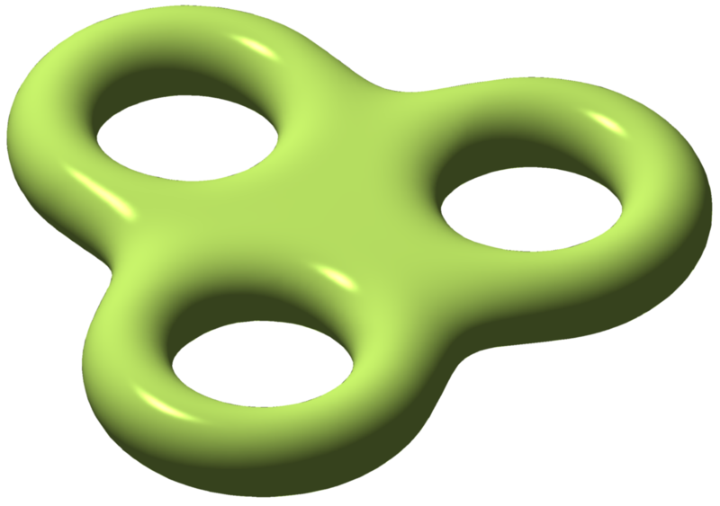
Genus example
genus 0
genus 1
genus 2
genus 3
http://en.wikipedia.org/wiki/Genus_(mathematics)

Slide 5
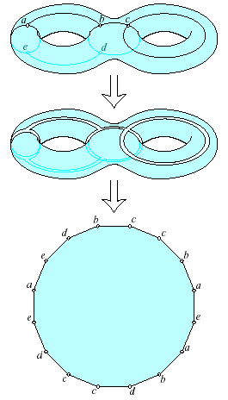
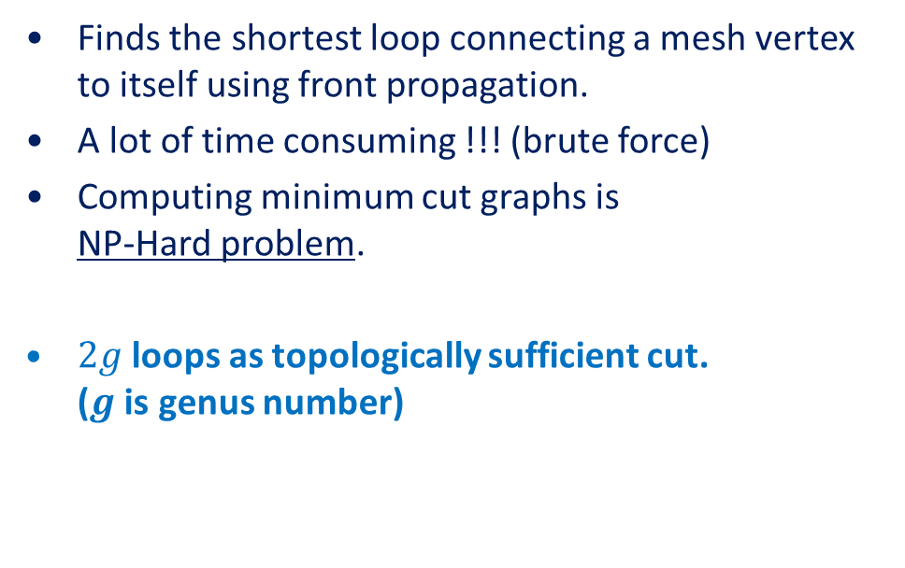
Previous Study
Optimally cutting a surface into a disk Jeff Erickson and Sariel Har-Peled, 2002.
Finds the shortest loop connecting a mesh vertex to itself using front propagation.
A lot of time consuming !!! (brute force)
Computing minimum cut graphs is NP-Hard problem.
$2g$ loops as topologically sufficient cut. ($g$ is genus number)

Slide 6
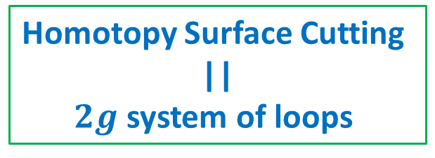
Previous Study
Greedy Optimal Homotopy and Homology Generators
Jeff Erickson and Kim Whittlesey, 2002.
a system of loops is a set of 2g simple loops (with a common basepoint) whose complement in the manifold is a topological disk.
Every system of loops is a homotopy basis, but the converse is not true; homotopy bases can contain (self-) intersections that cannot be removed by homotopy.
Homotopy Surface Cutting || $2g$ system of loops

Slide 7
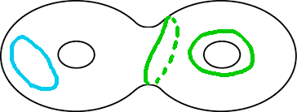
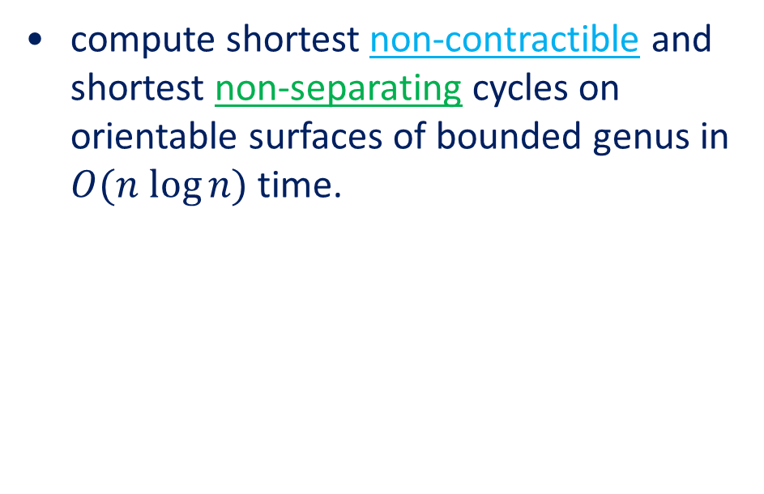
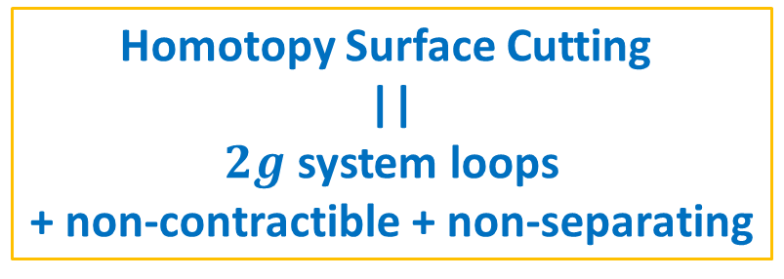
Previous Study
Computing Shortest Non-Trivial Cycles on Orientable Surfaces of Bounded Genus in Almost Linear Time
Martin Kutz, 2005
compute shortest non-contractible and shortest non-separating cycles on orientable surfaces of bounded genus in $O(n log⁡n)$ time.
Homotopy Surface Cutting || $2g$ system loops + non-contractible + non-separating

Slide 8
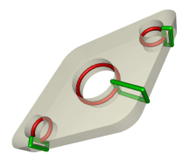
Tunnel And Handle
Computing geometry-aware handle and tunnel loops ., 2008 Dey, T. K., Li, K., Sun, J., and Cohen-Steiner, D.
Red circles area : Tunnel
Green circles area : Handle

Slide 9
Orignal Method
Geometry Images (SIGGRAPH 2002) X. Gu, S. Gortler, H. Hoppe.
Captures geometry positions as a simple 2D array.
sampling
reconstruct

Slide 10
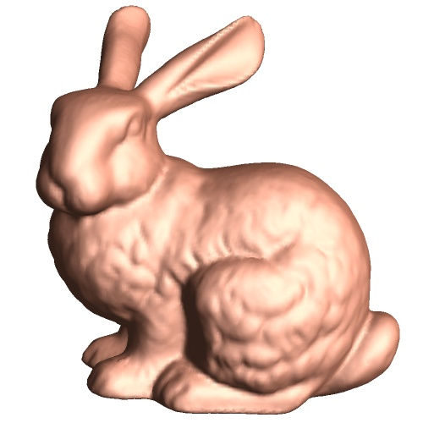
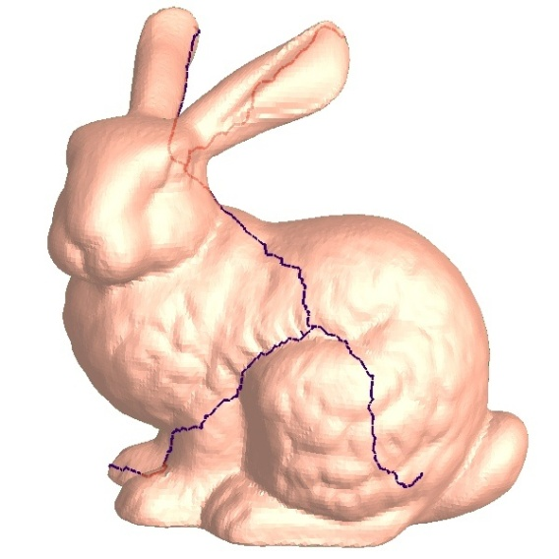
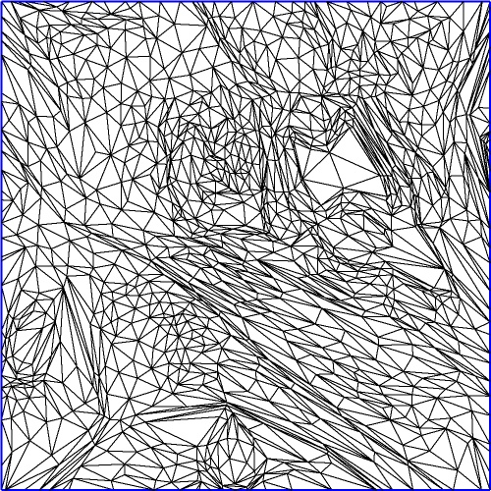

Creation of geometry images
i/(n-1) , j/(n-1)
Any kinds of 2-manifold mesh M
Opened-Mesh M’ with cut ρ’
Parametrization Φ in D square
(s,t)
cut ρ
Disk topology
Rectilinear on n×n grid

Slide 11
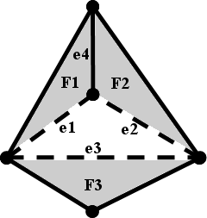
Original Homotopy Cutting
If mesh M has boundaries (holes), Let B be the set of original boundary edges
Remain frozen & include in final cut ρ
Remove seed triangle from M.
Have a queue for store list of edges, sorting by geodesic distance

Slide 12
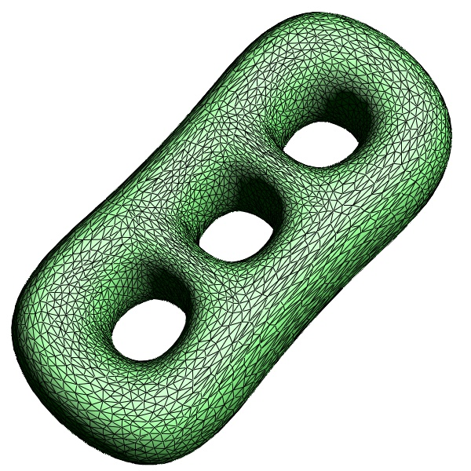
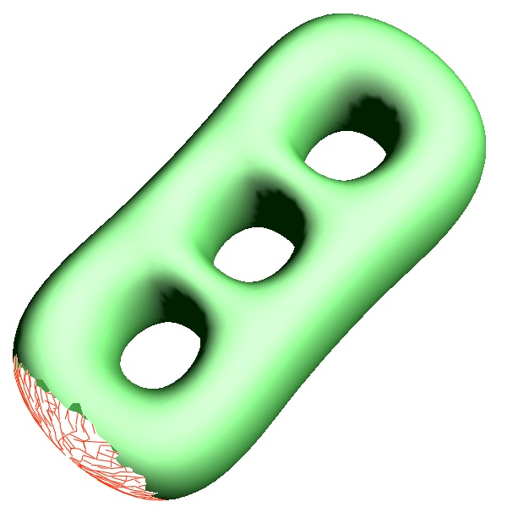
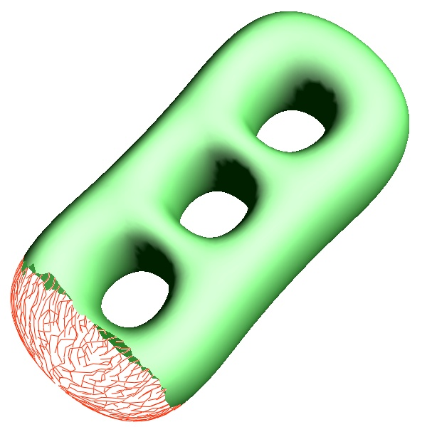
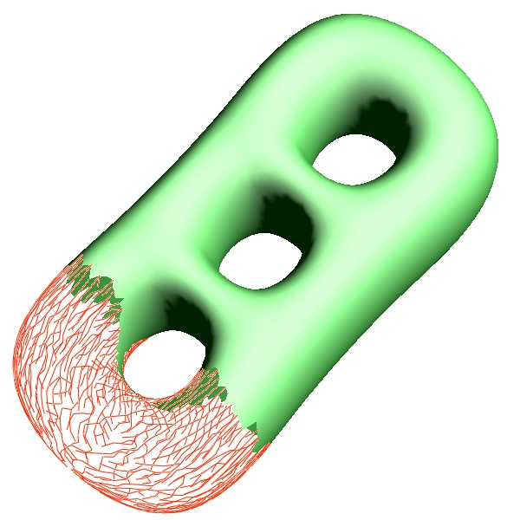
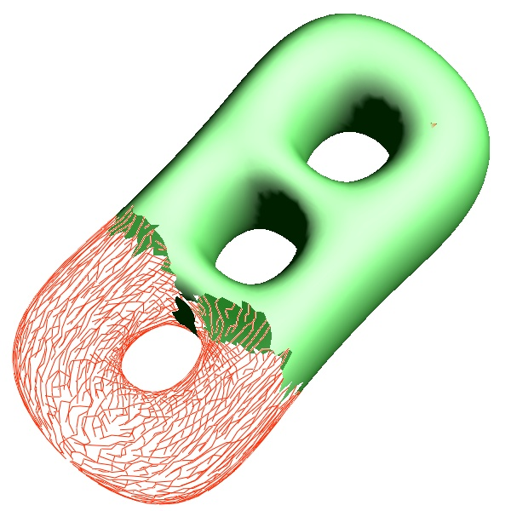
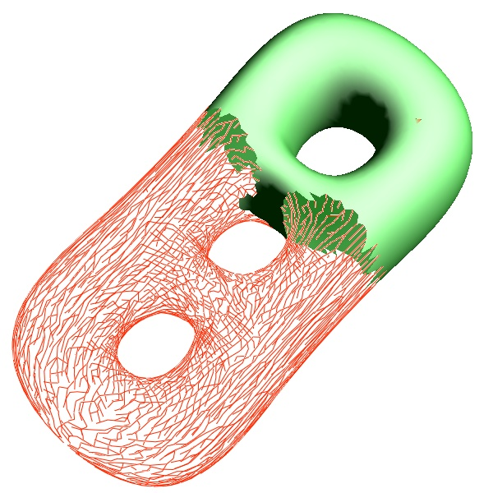
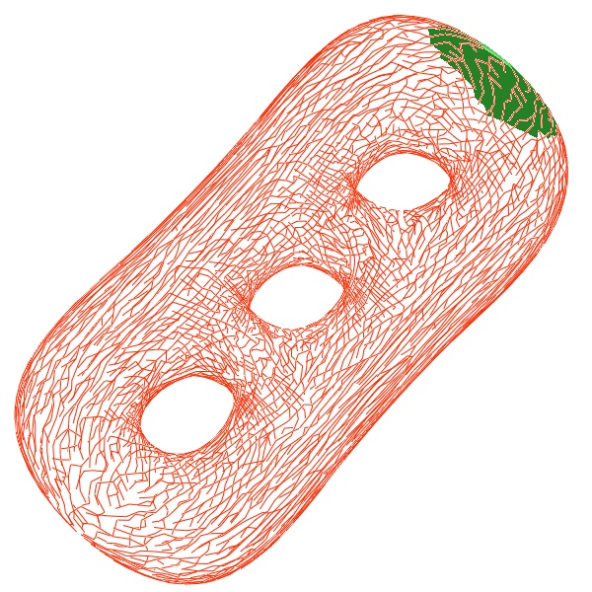
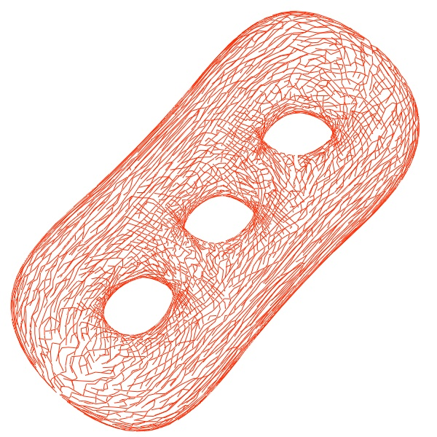
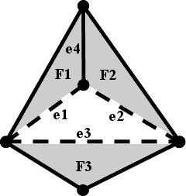
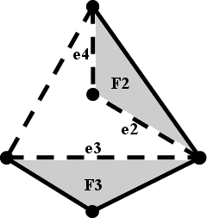
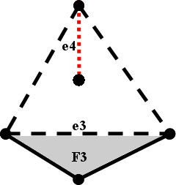
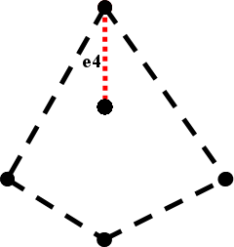
Original Homotopy Cutting
If mesh M has boundaries (holes), Let B be the set of original boundary edges
Remain frozen & include in final cut ρ
Remove seed triangle from M.
Repeatedly identify an edge adjacent to exactly one triangle that e ∉ B.
Remove that edge and triangle. (2 remains edge are left)
Adjacent only one triangle: e3
Adjacent only one triangle:
Adjacent only one triangle: (ordering by geodesic distance from seed triangle) e1 e2 e3
Adjacent only one triangle: e2 e3
e4
Adjacent only one triangle: e3
e4

Slide 13
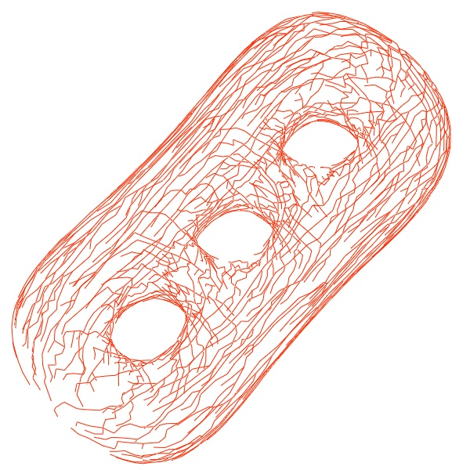
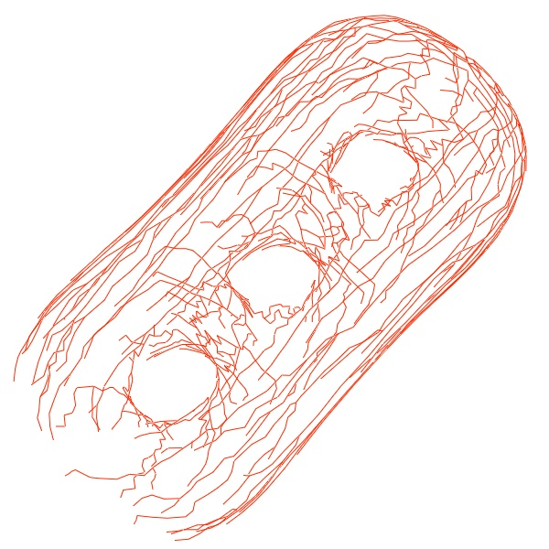
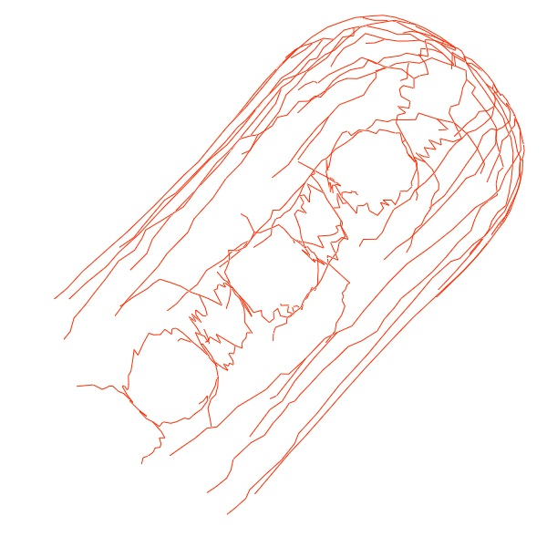
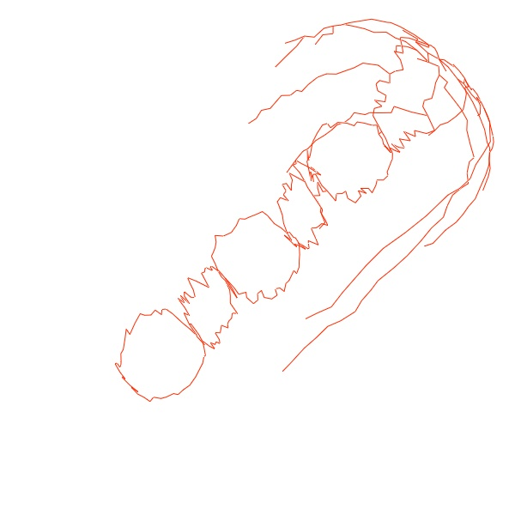
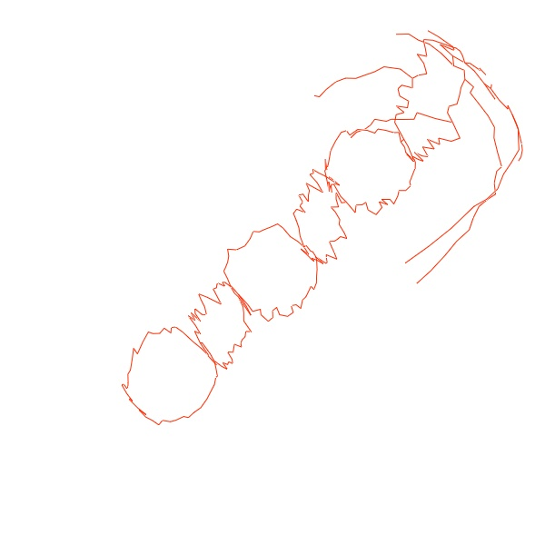
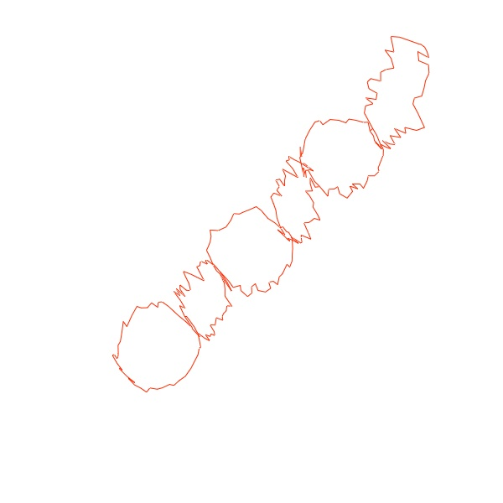
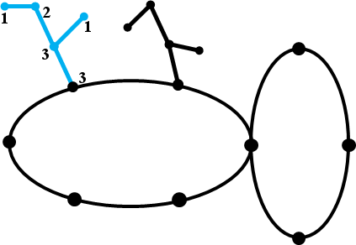

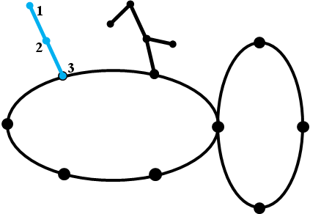
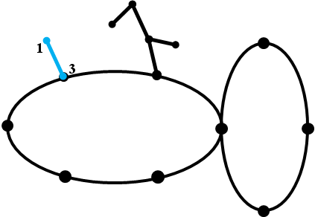
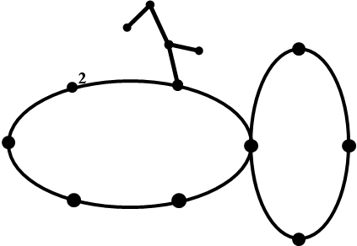
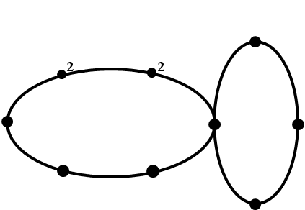
Original Homotopy Cutting
If mesh M has boundaries (holes), Let B be the set of original boundary edges
Remain frozen & include in final cut ρ
Remove seed triangle from M.
Repeatedly identify an edge adjacent to exactly one triangle that e ∉ B.
Remove that edge and triangle. (2 remains edge are left)
Repeatedly identify a vertex adjacent to exactly one edge. (Remove dangling edges)
Remove both vertex and the edge.

Slide 14
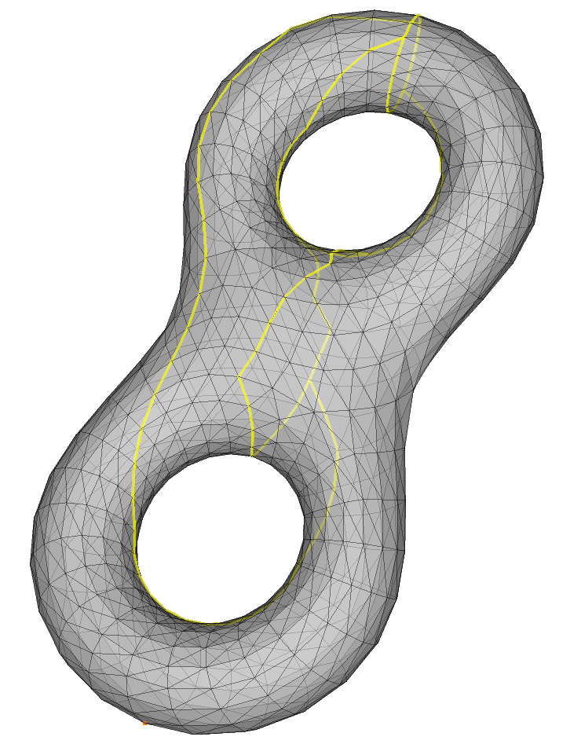
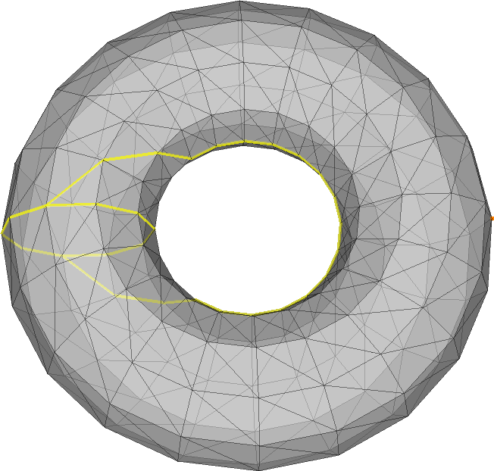
Some problems
Paths are not inner enough at tunnel areas. (affect to further processing)
Notes:
Unbalance cut loop which cause low quality result in further processing. We need path at mesh’s tunnel as possible.
We investigate at geodesic distance algorithm

Slide 15
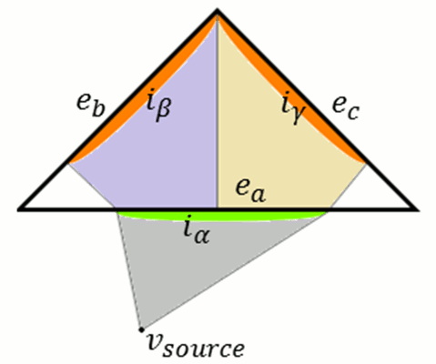
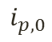
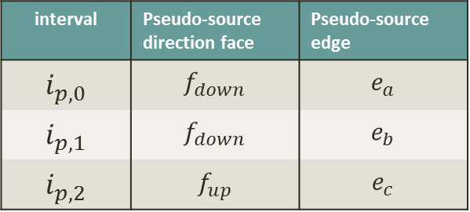
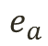
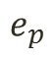
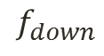
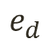





MMP Geodesic Distance
The Discrete Geodesic Problem Mitchell, J. S. B., Mount, D. M., Papadimitriou, C. H.
exact shortest paths across faces on a triangular mesh.
a set of intervals of each edge An interval represents an accessible pencil of lines from its pseudo-source.
$$e_{d}$$
$$e_{c}$$
interval | Pseudo-source direction face | Pseudo-source edge
$$i_{p,0}$$ | $$f_{down}$$ | $$e_{a}$$
$$i_{p,1}$$ | $$f_{down}$$ | $$e_{b}$$
$$i_{p,2}$$ | $$f_{up}$$ | $$e_{c}$$
$$f_{up}$$
$$e_{p}$$
$$i_{p,2}$$
+
$$i_{p,0}$$
$$i_{p,1}$$
$$e_{a}$$
$$f_{down}$$
$$e_{b}$$

Slide 16


Our Idea for enhancement
Path at inner of mesh’s tunnel as possible.
MMP geodesic distance on a high genus model , we can see some sharp pattern on texturing.
Sharp pattern area seems to be a good cut path.

Slide 17
Our method
Original: cut-path edges are created by propagation from a position, variant by removing edges order using geodesic distance metric.
Ours: cut graph in the area where it has the same geodesic distance (from a position) but its pseudo-sources come from different edges and faces.
detect areas where geodesic distance’s paths are crossing together in a set of edges

Slide 18




Edges: Pseudo-sources of intervals from both sides
Crossing at the edge
Not much detected
$$e_{d}$$
interval | Pseudo-source direction face | Pseudo-source edge
$$i_{a,1}$$ | $$f_{l}$$ | $$e_{b}$$
$$i_{a,2}$$ | $$f_{r}$$ | $$e_{c}$$

Slide 19





Edges: Non-propagation intervals
Crossing at inside a face that the edge adjacent with
edge | All intervals’ P.S. direction face | checking |  | Any P.S. of checking edges from processing edge
 |  | Face | Edges
$$e_{a}$$ | $$f_{l}$$ | $$f_{r}$$ | $$e_{b},e_{c}$$ | No
$$e_{c}$$ | $$f_{p}$$ | $$f_{r}$$ | $$e_{a},e_{b}$$ | Yes
$$f_{p}$$

Slide 20



Remove Dangling Edges
Use same process as original (Remove valence-1 edge and vertex)
After removed: forming a roughly $2g$ loop with contractible cycles.
$$E_{crossing}$$

Slide 21


Ensure for non-separating
There is a rare case that $E_{crossing}$ has separating between each loop
We include “neighbor edges of $E_{crossing}$” as$E_{neighbor}$
And let$E_{others}=∀E −E_{crossing}−E_{neighbor}$

Slide 22

Ensure of non-contractible
while ( Q_{crossing} .size() > 0 || Q_{neighbor} .size() > 0 || Q_{others} .size() > 0 )
{
if ( Q_{others} .size() > 0 )
remove_edge_face(Q_{others} .smallest_geoDistEdge());
else if ( Q_{neighbor} .size() > 0 )
remove_edge_face(Q_{neighbor} .smallest_geoDistEdge());
else if ( Q_{crossing} .size() > 0 )
remove_edge_face(Q_{crossing} .smallest_geoDistEdge());
register_new_adj_one_triangle_to_queues();
}
Want valid cut paths at $E_{crossing}$ as possible.
Use original method with a modification
Original: single queue on adjacent to one triangle edges.
Ours: three queue on adjacent to one triangle edges.
Three queues are based on types with priority. $$priority:E_{others}<E_{neighbor}<E_{crossing}$$
Remove edges at lower priority first.

Slide 23
Overall Process

Slide 24



Results
Paths are more inner at tunnel areas on most sym. shape. (with a proper seed position)
Paths are almost same with original method on asym. shape
■ original ■ ours
Notes:
Paths seems give a better result.

Slide 25





Performance
Model | g | L² error (square param.) |  | Homotopy Cal. Time (sec)
 |  | original | Our | original | our
Torus | 1 | 1.351 | 1.335 | 0.006 | 0.009
Thin torus (a) | 1 | 1.492 | 1.468 | 0.014 | 0.030
Thick torus (b) | 1 | 1.551 | 1.417 | 0.040 | 0.106
Eight | 2 | 1.667 | 1.466 | 0.028 | 0.051
3-holes chain (c) | 3 | 1.457 | 1.452 | 0.489 | 1.217
3-holes tetrahedral (d) | 3 | 939.2 | 1.625 | 0.497 | 1.163
Neptune (e) | 3 | 221.3K | 79.9K | 0.110 | 0.142
(a)
(b)
(c)
(d)
(e)
Notes:
Our method’s processing time is about double of original time. Of cause there are a few cases that L2 original is lower than proposed method.

Slide 26


Parallel Processing
We can optimize by parallel processing at detecting 2 types of edges ($E_{crossing}$)
Model | g | Number of edges | Homotopy Cal. Time (sec)
 |  |  | original | our
Torus | 1 | 600 | 0.006 | 0.009 → 0.007
Thin torus | 1 | 1500 | 0.014 | 0.030 → 0.018
Thick torus | 1 | 3456 | 0.040 | 0.106 → 0.051
Eight | 2 | 2304 | 0.028 | 0.051 → 0.031
3-holes chain | 3 | 19716 | 0.489 | 1.217 → 0.607
3-holes tetrahedral | 3 | 19968 | 0.497 | 1.163 → 0.599
Neptune | 3 | 7500 | 0.110 | 0.142 → 0.128
Notes:
Our method’s processing time is now about 20% more of original time

Slide 27

Conclusion
an enhancement method to generate a cut graph in high-genus surface for converting surface into topological disk.
$2g$ loops, non-contractible and non-separating
Detecting geodesic path crossing.
More inner path at tunnel area of symmetric shape.

Slide 28


Open topics
This methods requires manual starting position (seed position)
Where is the optimal starting position?
How is improve result on asym. shape?
Move common point in loops ?

Slide 29
Q & A
Thank you very much

Slide 30
while ( Q_{crossing} .size() > 0 || Q_{neighbor} .size() > 0 || Q_{others} .size() > 0 )
{
if ( Q_{others} .size() > 0 )
remove_edge_face(Q_{others} .smallest_geoDistEdge());
else if ( Q_{neighbor} .size() > 0 )
remove_edge_face(Q_{neighbor} .smallest_geoDistEdge());
else if ( Q_{crossing} .size() > 0 )
remove_edge_face(Q_{crossing} .smallest_geoDistEdge());
register_new_adj_one_triangle_to_queues();
}

